Slide 1
Insurance Forecast
Brandon White
Jethro Aderele
Tyler White

Slide 2

What is our purpose
Create web app interface that uses machine learning to accurately predict insurance claim charges based off one’s characteristics
Features used to make these predictions were:
Smoker/Non Smoker
Children/No Children
Age
Sex
Region

Slide 3
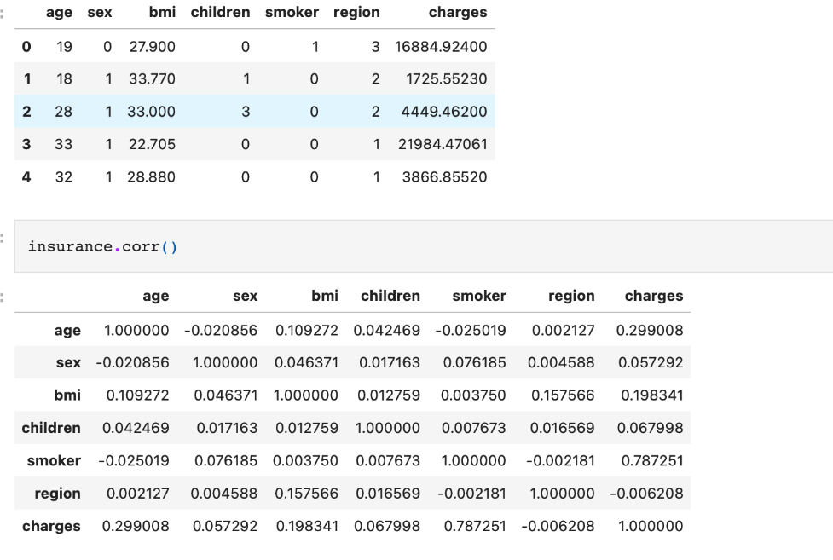
Data clean up and model training
We did basic data cleansing on the data once receiving it
Data was mostly clean initially
No problems were encountered
Only problem we had was the training times of each model (took a couple hours to train)

Slide 4
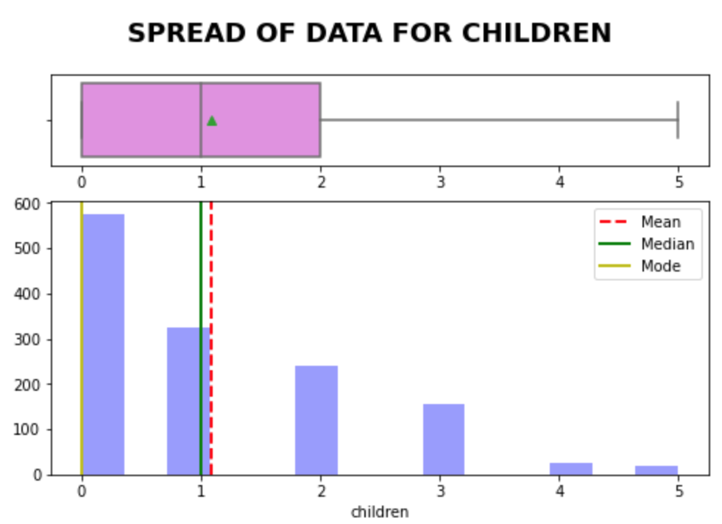
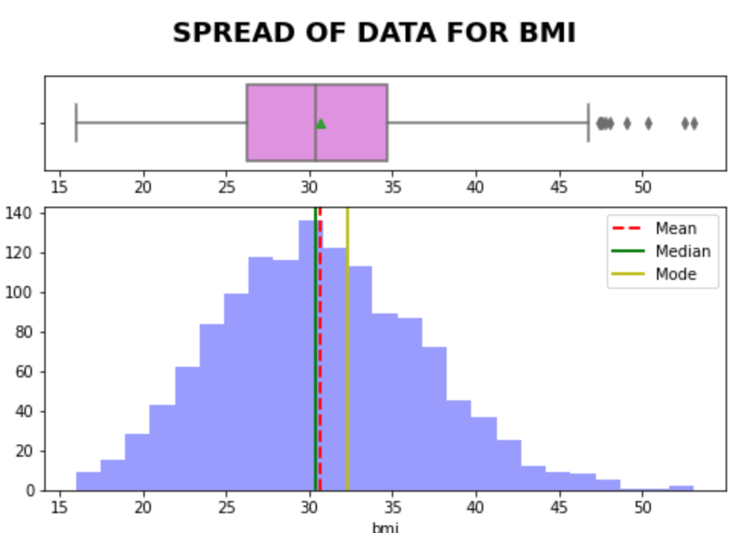
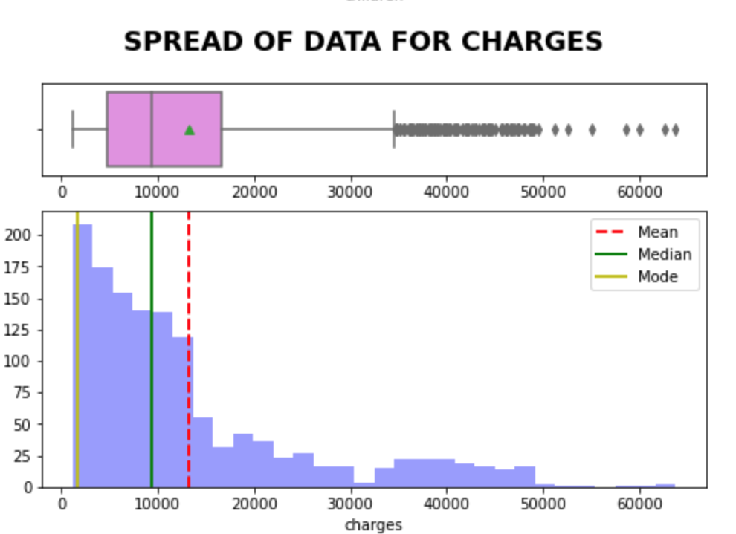
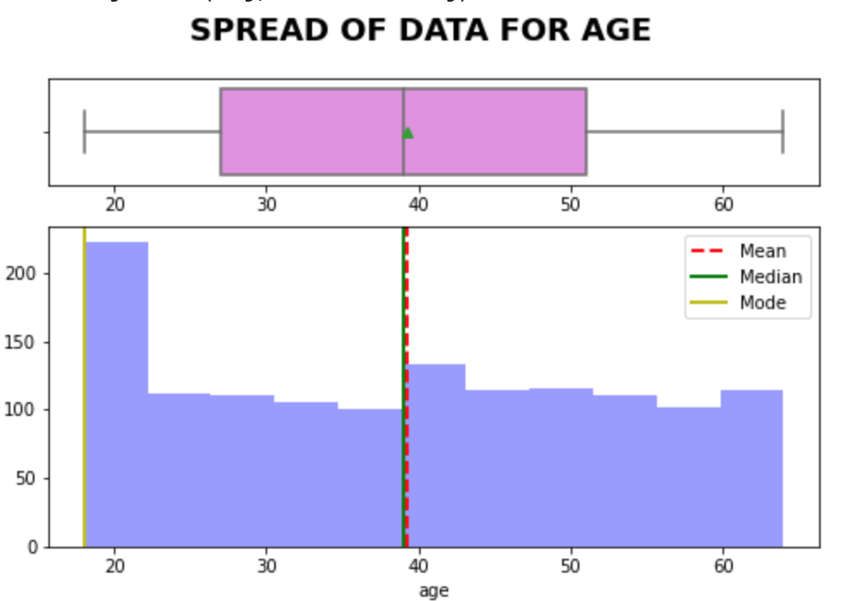
How related are our features?

Slide 5
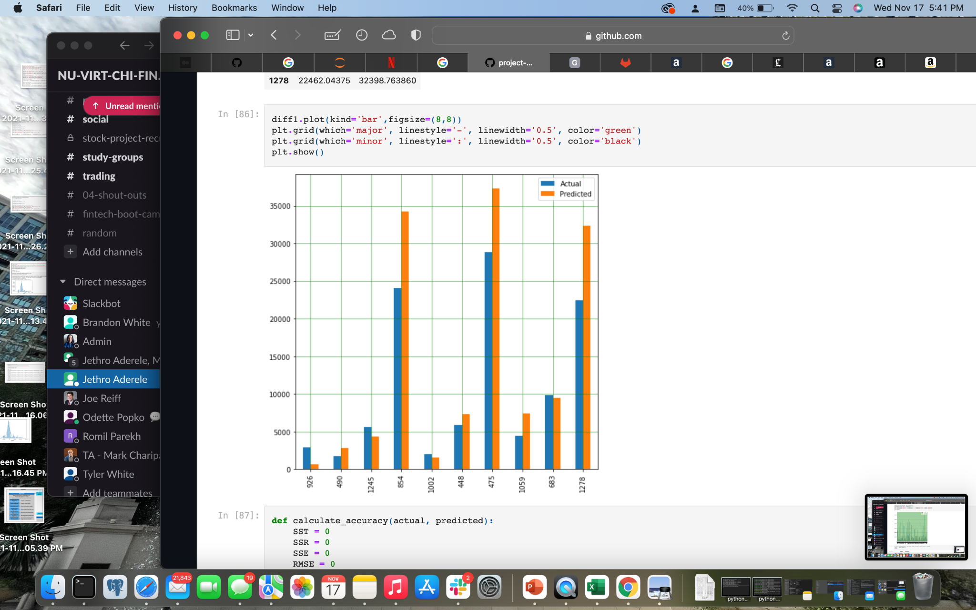
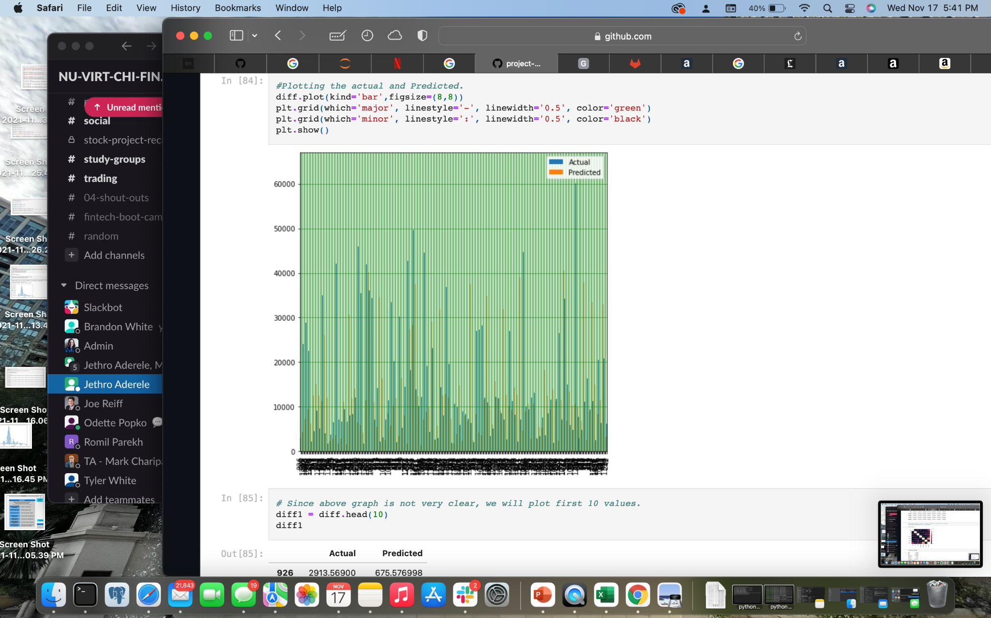
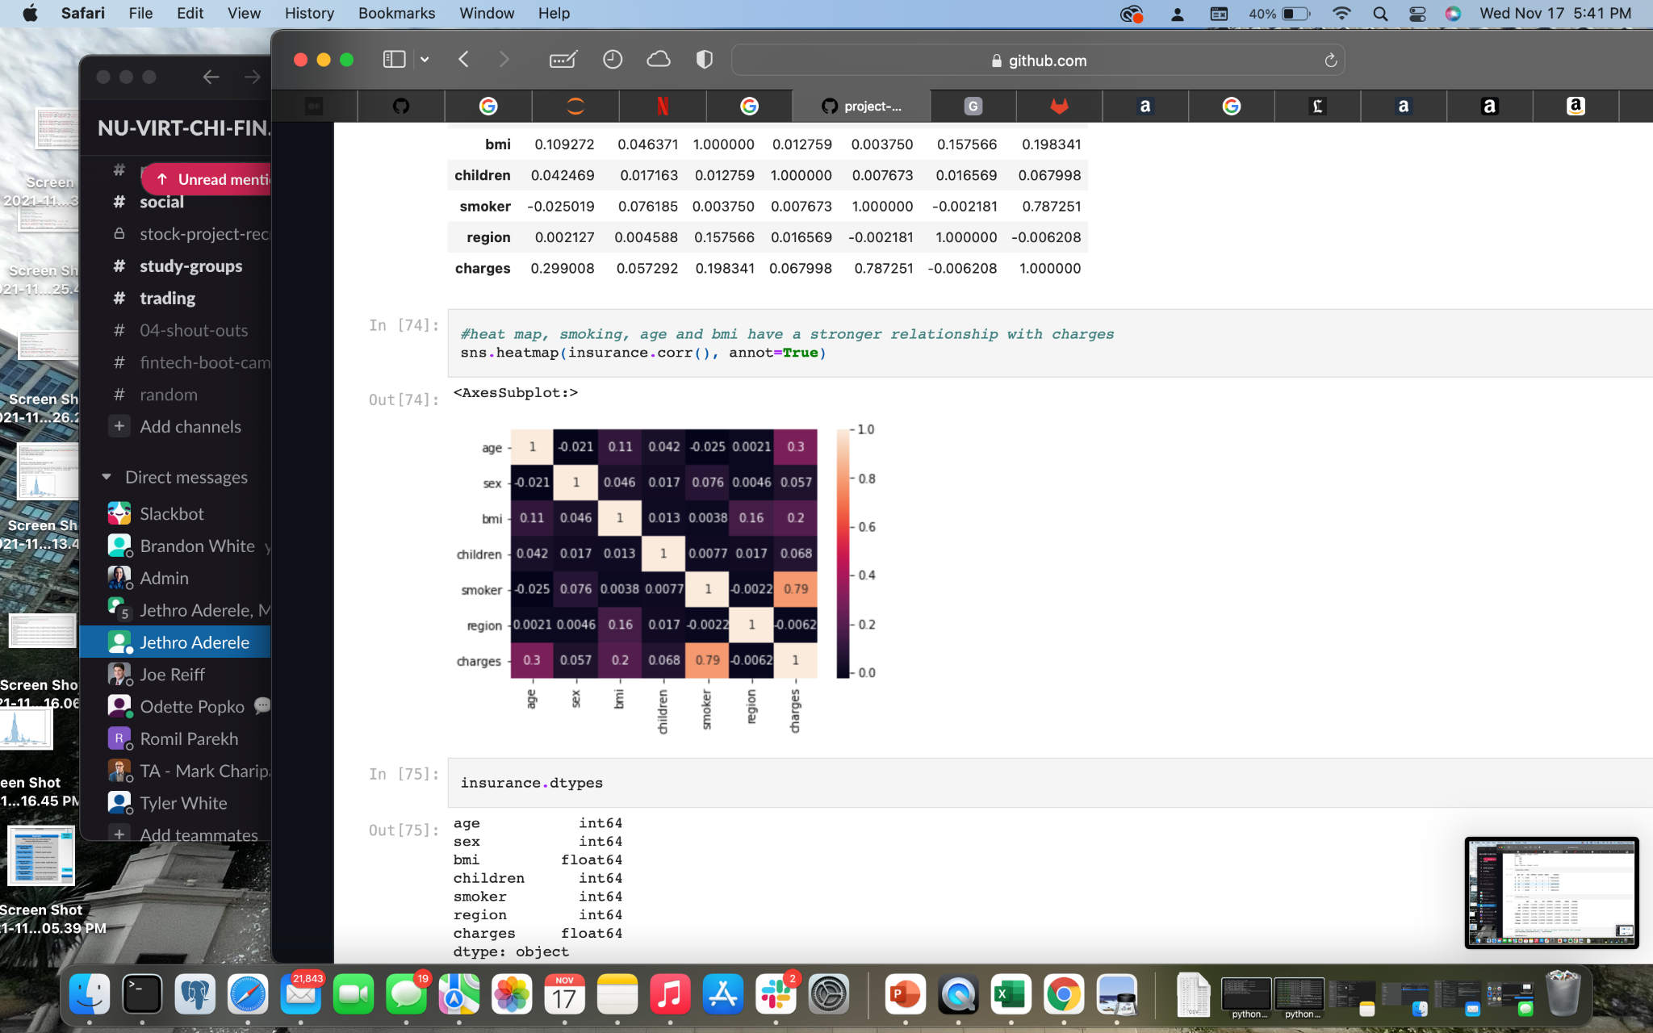

Slide 6
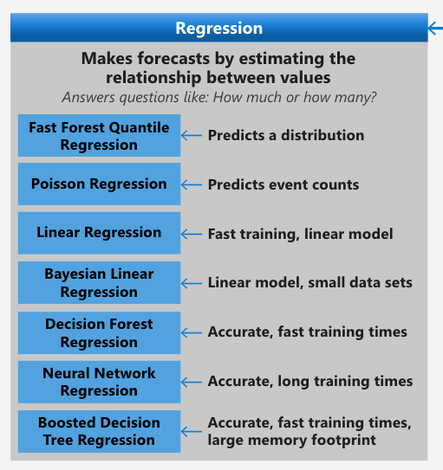
Models in our Arsenal
The models we used were:
Random Forest
Linear Regression
Decision Tree
Lasso regression
Ridge regression
SRV

Slide 7
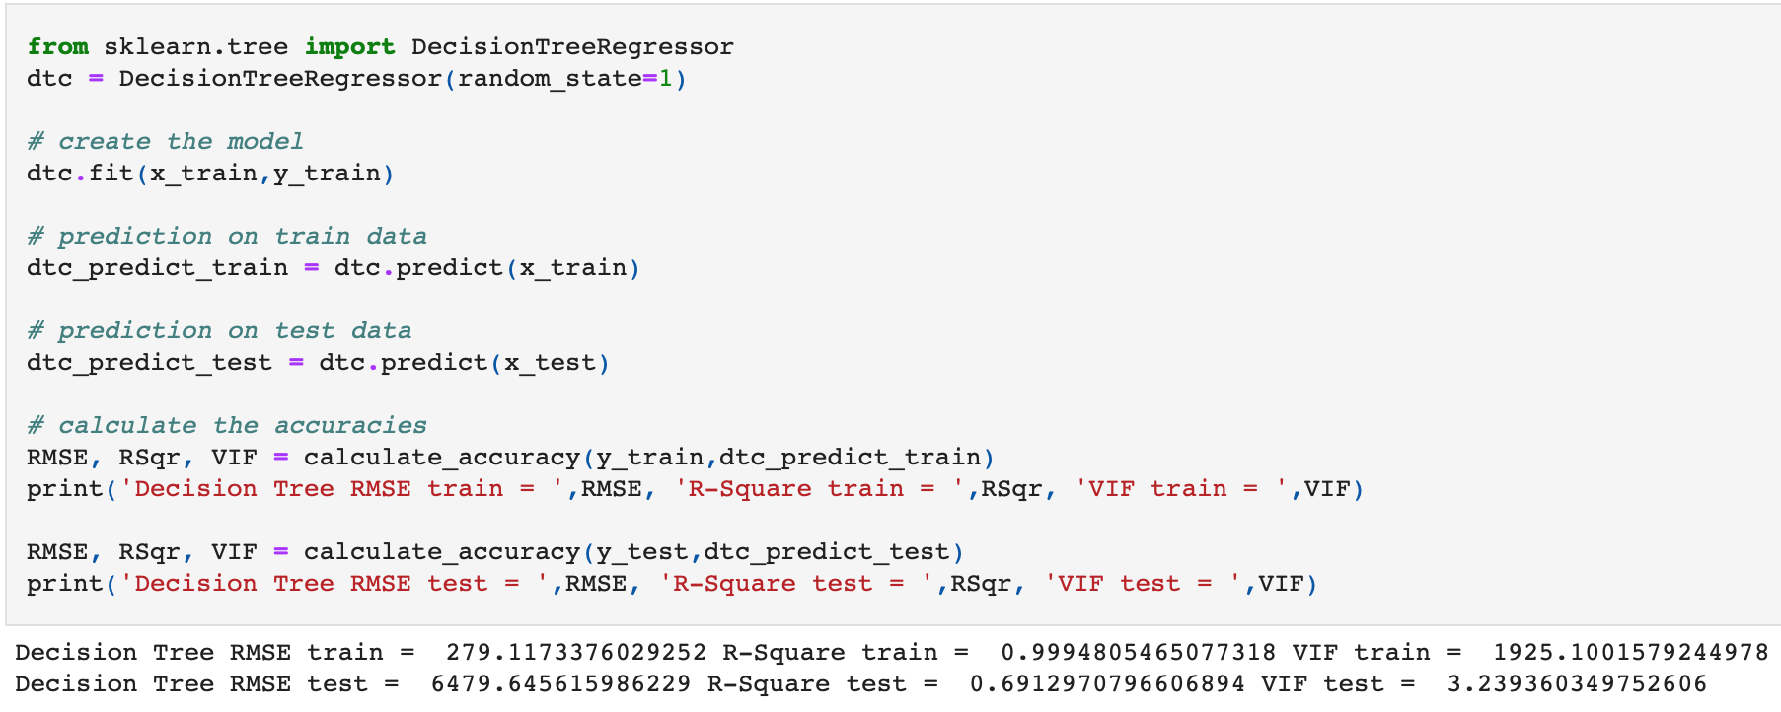
Decision Tree

Slide 8
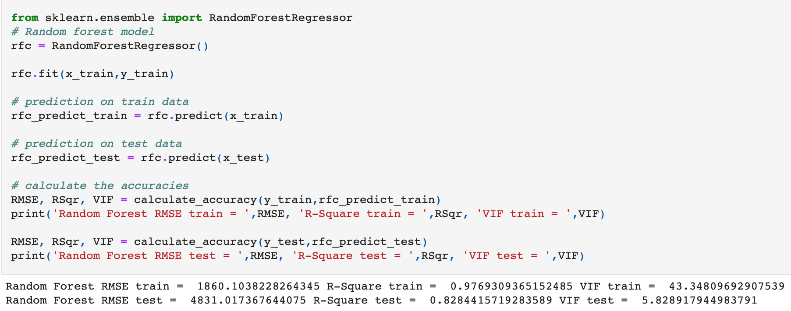
Random Forest

Slide 9
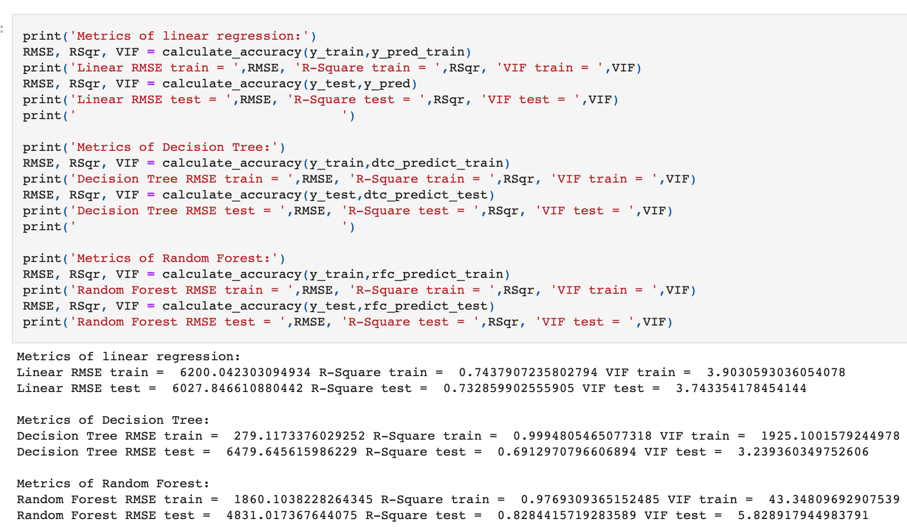
Linear Regression

Slide 10
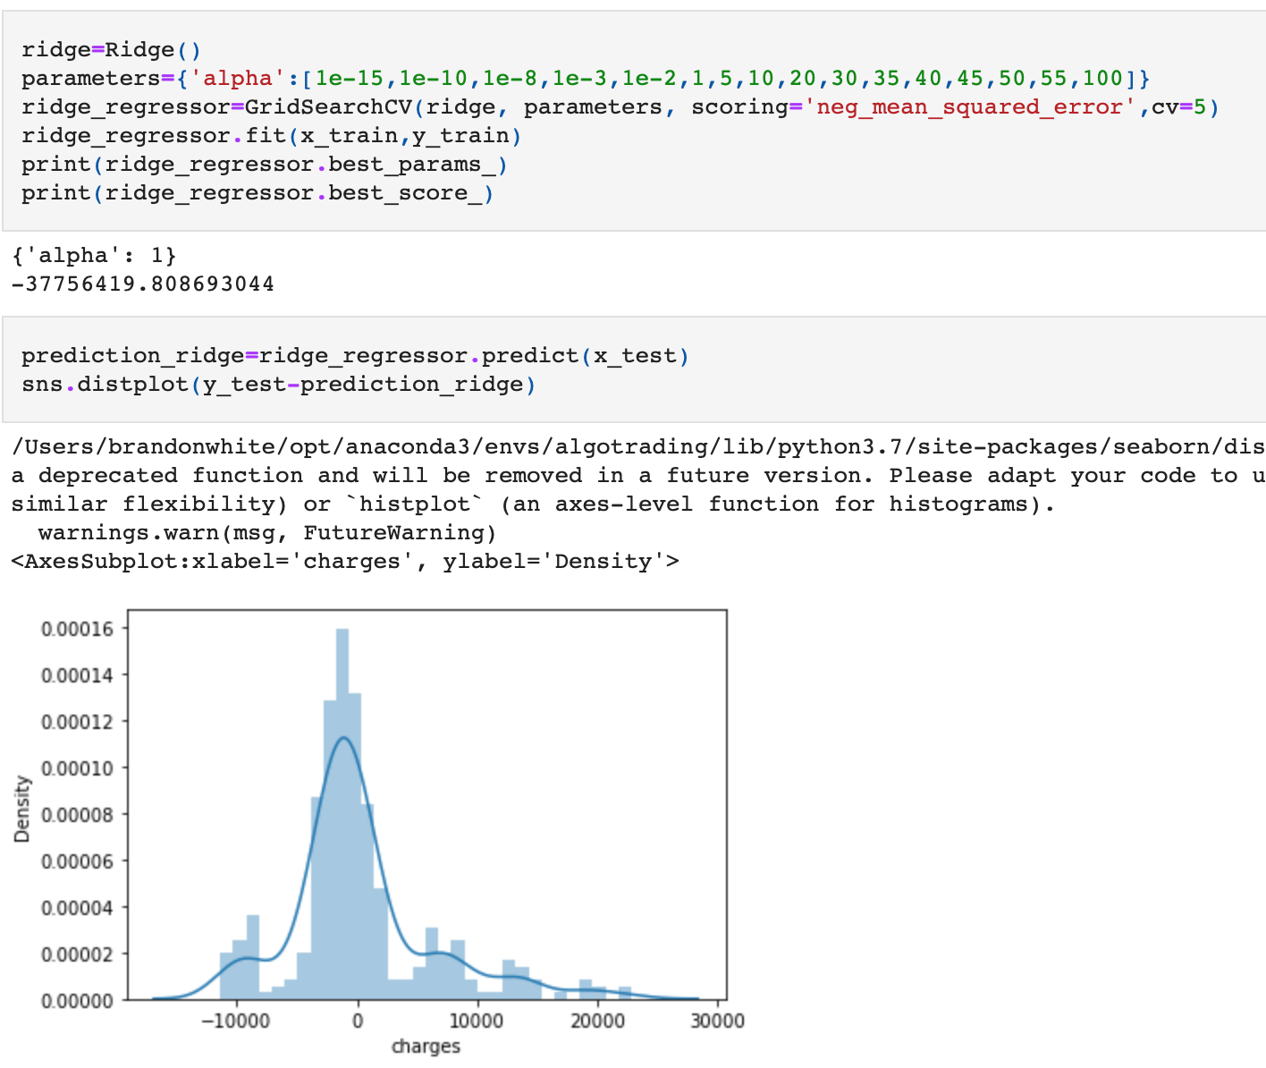
Ridge regression

Slide 11
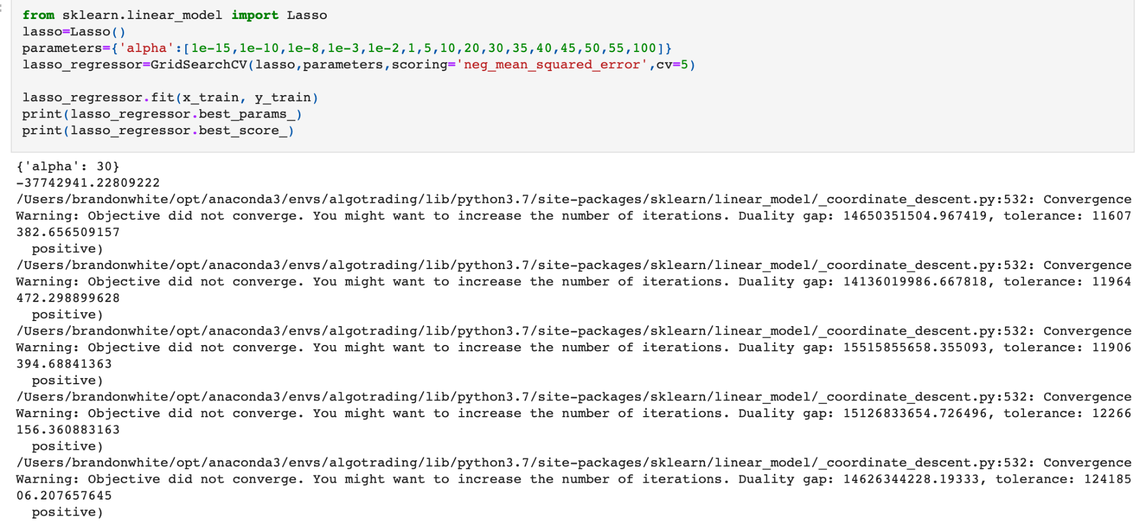
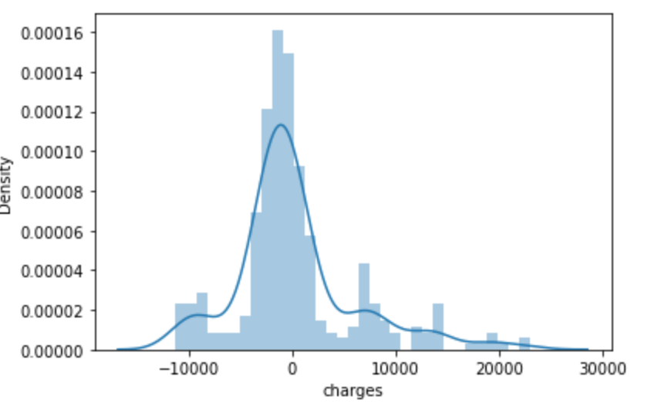
Lasso Regression

Slide 12
How we analyzed the models
We analyzed the end score of each model ( The closer to zero the more accurate it is)
Concluded Random Forest was the most accurate

Slide 13

The challenges we faced
Deciding on which Models to use
Used Slack resources and researched via the web
Making model more accurate
Making the features more compatible with models
Issues deploying Web App

Slide 14
Questions

